Slide 1
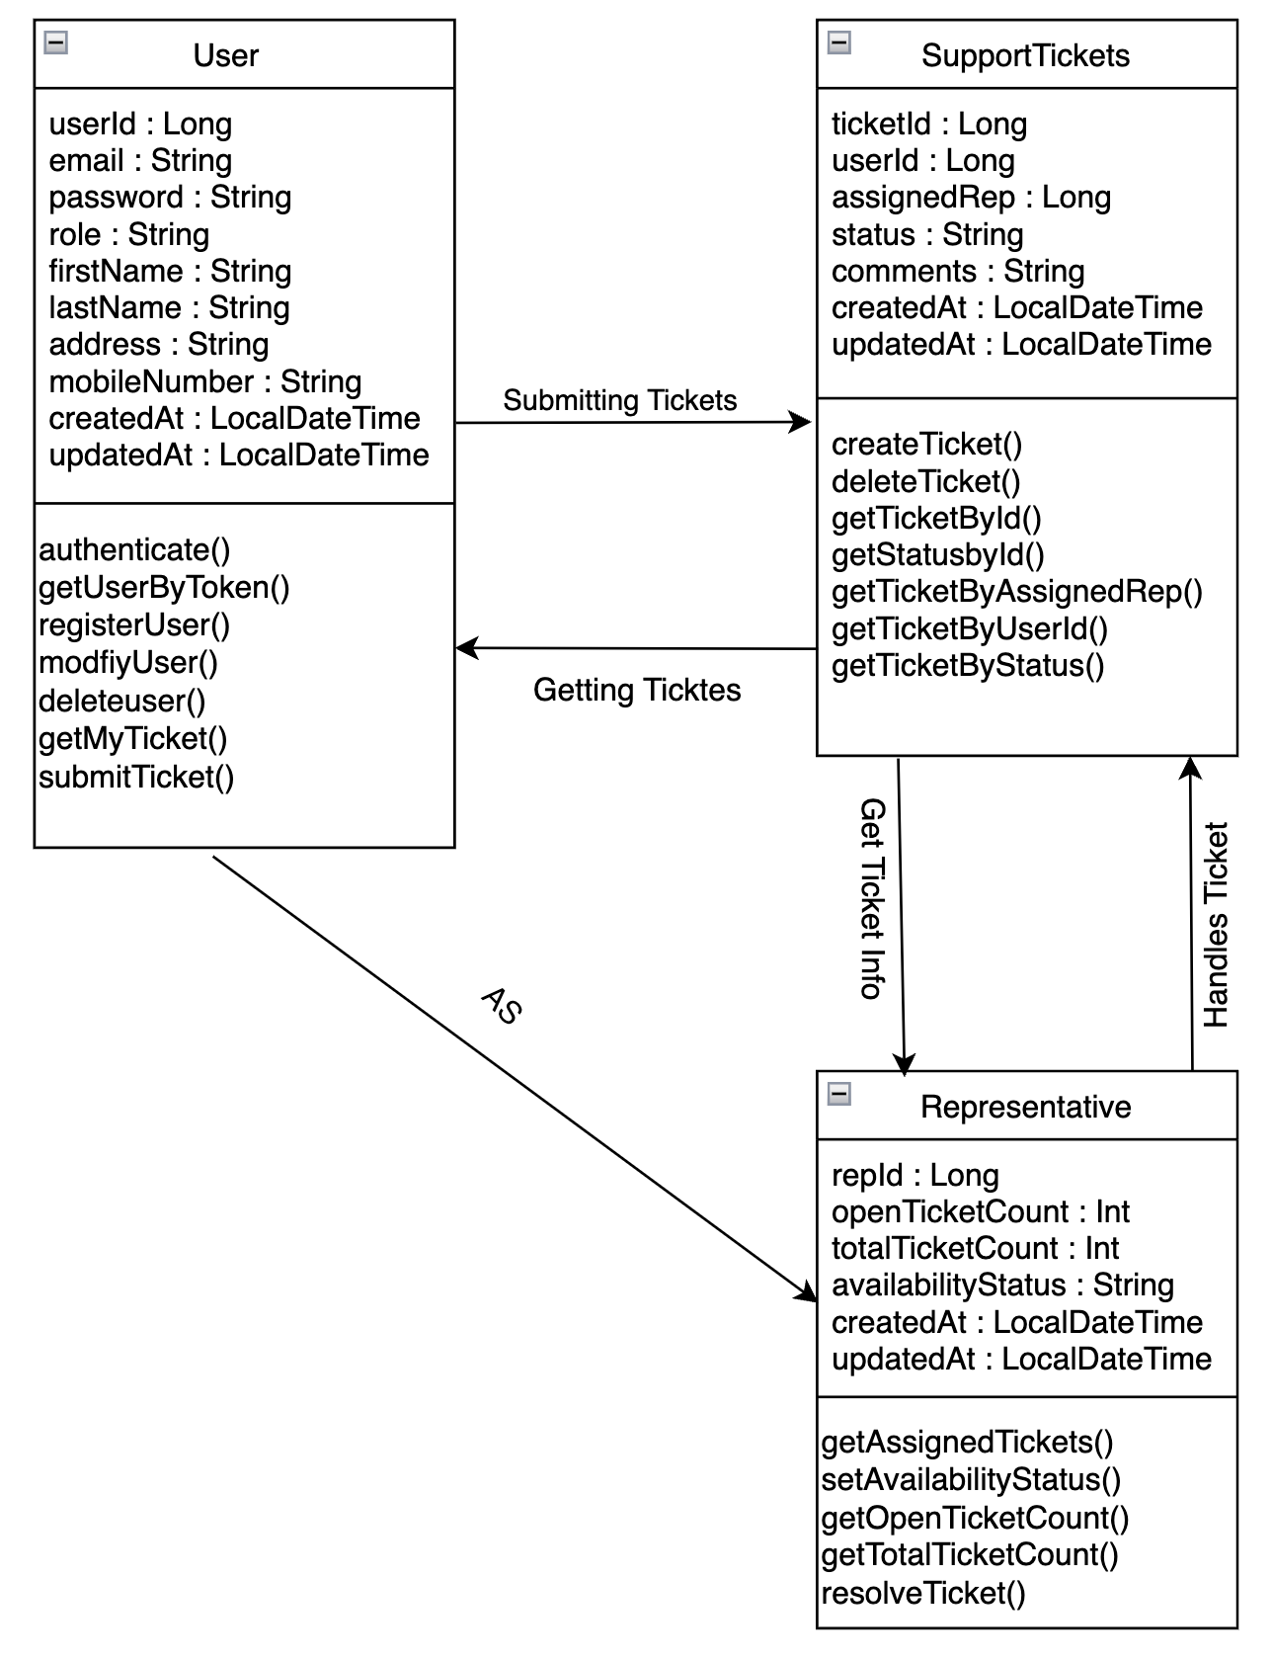
Class Diagram
Application : Reviewer

